Slide 1
 | EVENTS | ERA
 | Translation Transtension, Transpression Terracing | LATE CENOZOIC
 | Under-plating Uplift Un-roofing Undulating | EARLY CENOZOIC
 | Magmatic Madness Metamorphism | MESOZOIC
 | Stable Shelf Sedimentation | PALEOZOIC
T
U
Subduction flattens
M
S
Notes:
Although subduction continued during the Early Cenozoic, it differed significantly compared to that of the Mesozoic.

Slide 2
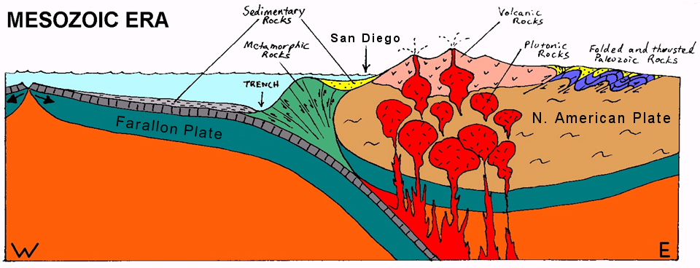
Early
Notes:
Whereas the subduction angle of the Farallon Plate was relatively steep during the Early Mesozoic and associated magmatism correspondingly close to the trench, …

Slide 3
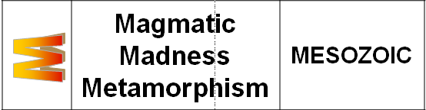
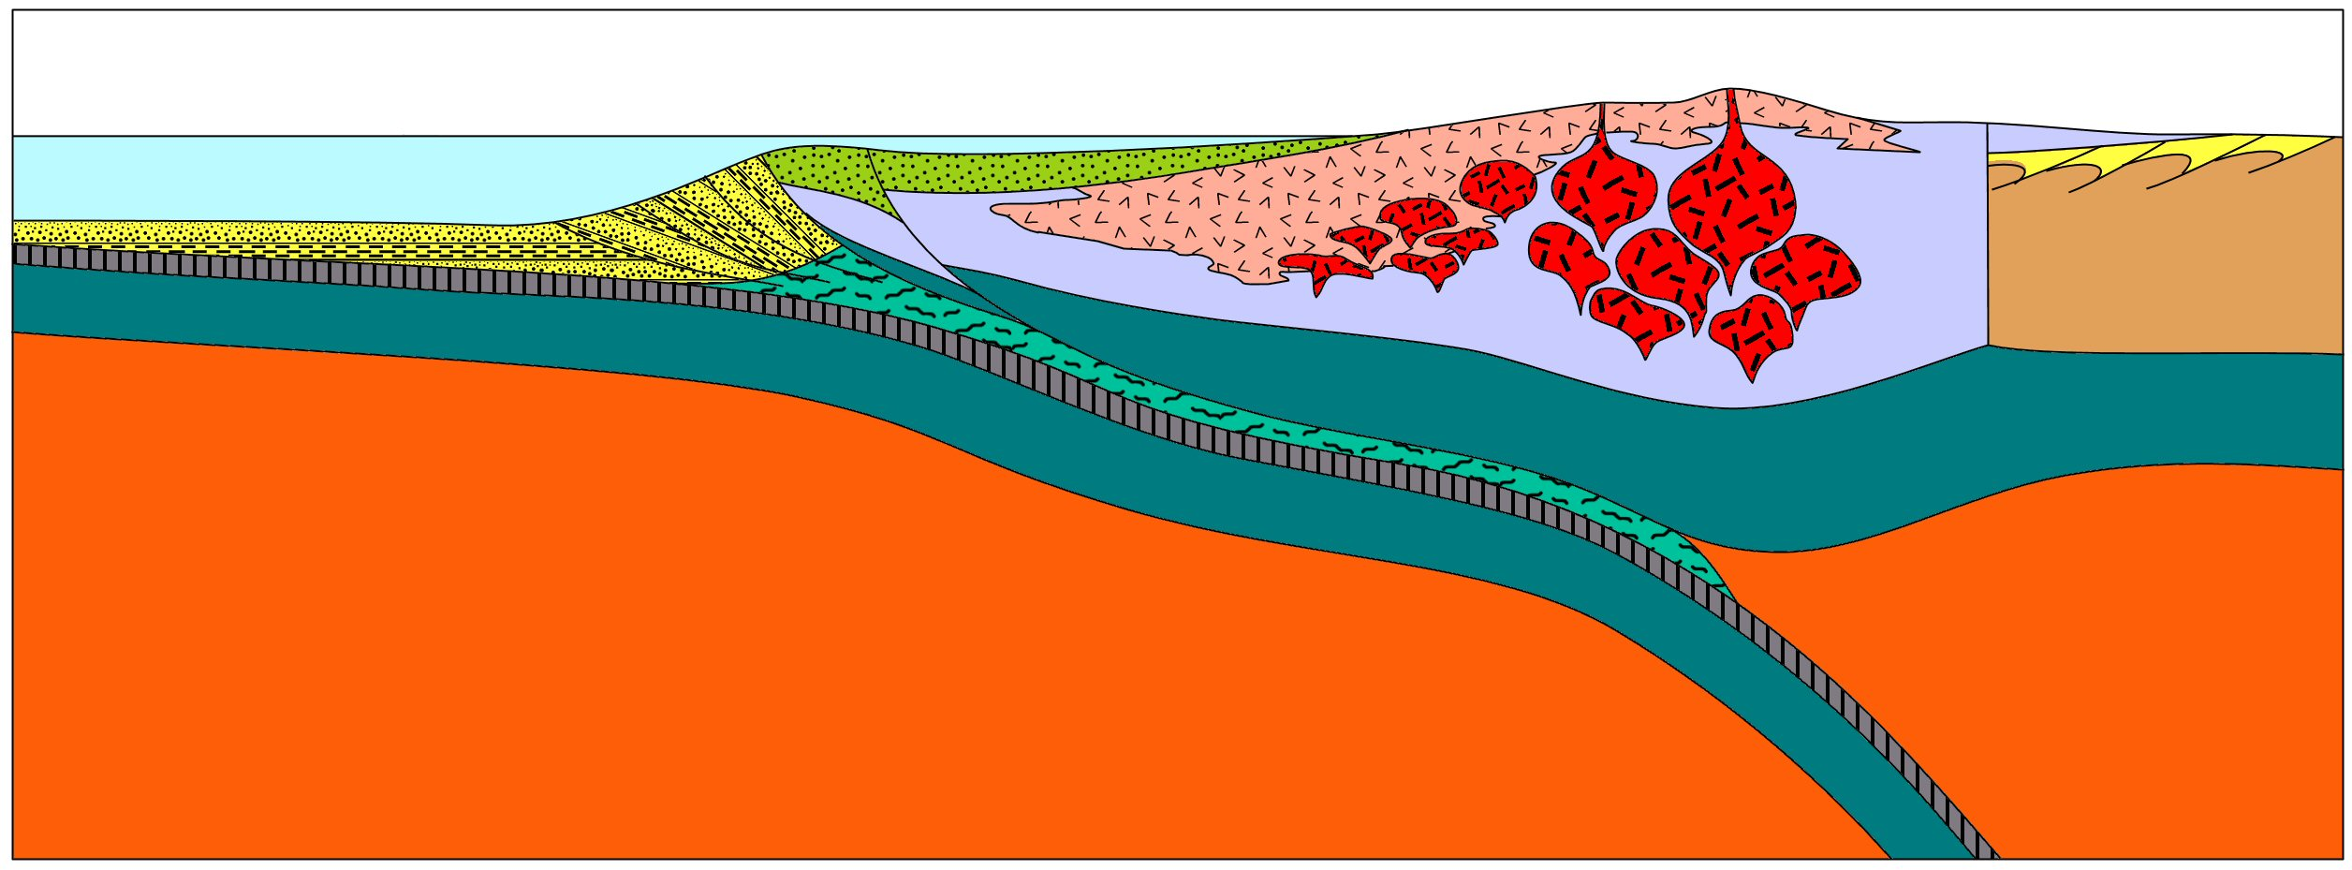
Late
Accretionary Wedge
Forearc Basin
Regional Metamorphism
Forearc thrusting and subduction erosion
Peninsular Ranges Batholith
Metamorphosed wedge sediments (Catalina Schist)
Notes:
… as the Mesozoic drew to a close the subduction angle of the Farallon Plate had flattened markedly, increasing stress on the forearc region and causing so much forearc thrust faulting and subduction erosion that eventually the subducted accretionary wedge sediments were moved next to the area where regional (Barrovian) metamorphism was taking place.

Slide 4
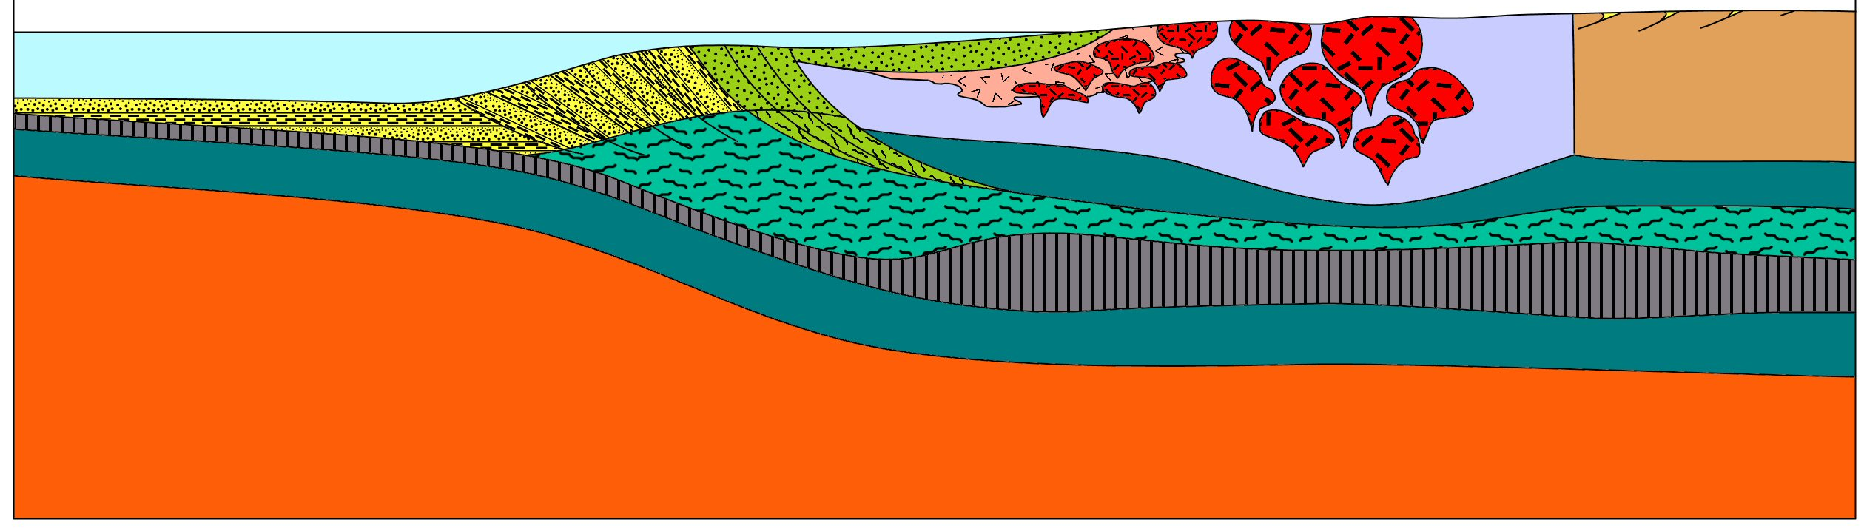
 | Under-plating Uplift Un-roofing Undulating | EARLY CENOZOIC
U
Forearc Basin
Catalina Schist
Orocopia Schist
subduction erosion
Unusually thick Farallon Plate
Magma production shifts east
Notes:
By the Early Cenozoic accelerated convergence between the Farallon and N. American plates, the encroachment of the East Pacific Rise and the subduction of an unusually thick portion of the Farallon Plate all contributed to a nearly flat subduction angle. This resulted in several significant changes including the relocation of magmatism much further east, ….

Slide 5
 | EVENTS | ERA
 | Translation Transtension, Transpression Terracing | LATE CENOZOIC
 | Under-plating Uplift Un-roofing Undulating | EARLY CENOZOIC
 | Magmatic Madness Metamorphism | MESOZOIC
 | Stable Shelf Sedimentation | PALEOZOIC
T
U
M
S
Notes:
… as well as several other events summarized by the “U” in SMUT.

Slide 6
 | Under-plating Uplift Un-roofing Undulating | EARLY CENOZOIC
U
East Pacific Rise approaches
Un-roofed batholith
Forearc Basin
Undulating peneplain
Uplift
Orocopia Schist
subduction erosion
Underplating
Unusually thick Farallon Plate
Notes:
Underplating here refers to the low-angle thrusting of the Farallon Plate beneath the N. American Plate. This was accompanied by the uplift of Southern California. The associated erosion un-roofed the peninsular ranges batholith (the mass of plutonic igneous rocks formed by Mesozoic subduction). That erosion left a low, somewhat undulating plane which sloped gently all the way from what today is Sonora, Mexico towards the Pacific coast. That surface allowed a vast amount of sediment to be transported west which deposited mostly in the forearc basin. Forearc thrust faults shoved some of that sediment under the leading edge of the continent along with a huge amount of wedge sediment that followed in the “wake” of the unusually thick part of the subducted Farallon Plate. As the East Pacific Rise approached the trench, the rate of sediment accumulation at the wedge would eventually taper off, however, because the subducted oceanic crust was much younger than it had been in the Mesozoic and thus carried far less sediment.

Slide 7
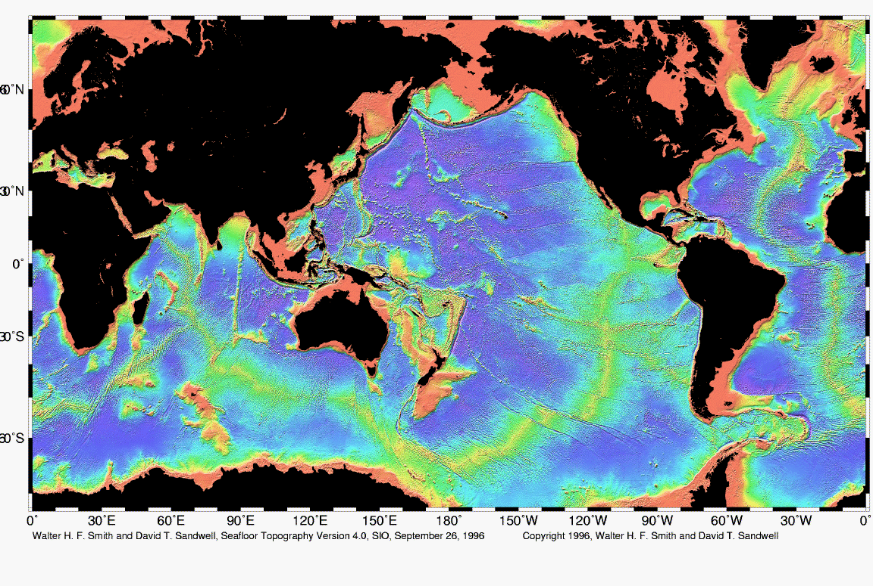
East Pacific Rise
Notes:
Accretion at the wedge completely ended when the sediment-free crust of the East Pacific Rise arrived at the margin of N. America. That meeting begins the final chapter of our saga in which we shall see how all that metamorphic rock was uplifted and exposed on Catalina.

Slide 8
 | EVENTS | ERA
 | Translation Transtension, Transpression Terracing | LATE CENOZOIC
 | Under-plating Uplift Un-roofing Undulating | EARLY CENOZOIC
 | Magmatic Madness Metamorphism | MESOZOIC
 | Stable Shelf Sedimentation | PALEOZOIC
T
U
M
S
Notes:
Represented by the “T” in SMUT, the Late Cenozoic arrival of the East Pacific Rise resulted in translational (sideways) motion to the continental borderland and the associated transtension (stretching) and transpression (squeezing). The following animation highlights the large scale plate interactions involved:

Slide 9
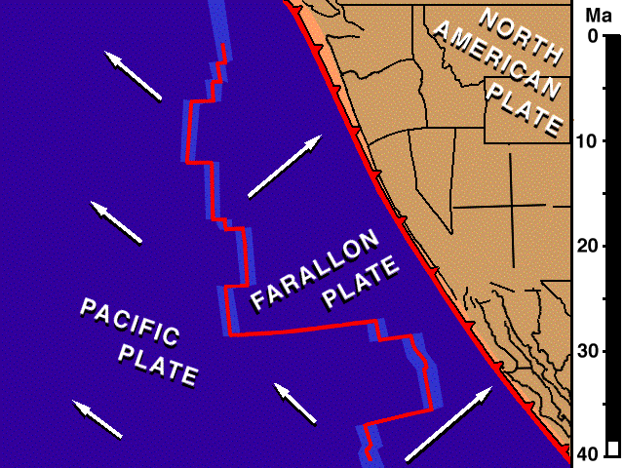
Notes:
Because the East Pacific Rise moved north as well as east, the Pacific and Farallon Plates had a northerly component superimposed on their divergence from the East Pacific Rise. The resultant motion of the Pacific Plate was therefore towards the northwest. Since this was parallel to the orientation of the trench, when the Pacific Plate arrived at the trench, the plate boundary changed from convergent to transform. As more of the Pacific Plate was brought into contact with the North American Plate, the transform plate boundary lengthened into the San Andreas Fault. The conversion to a transform plate boundary removed compressive stress on the western margin of North America, which allowed it to spread laterally while shear stress from the Pacific Plate ripped off great hunks of the North American Plate (like Baja California) and carried them to the northwest.

Slide 10
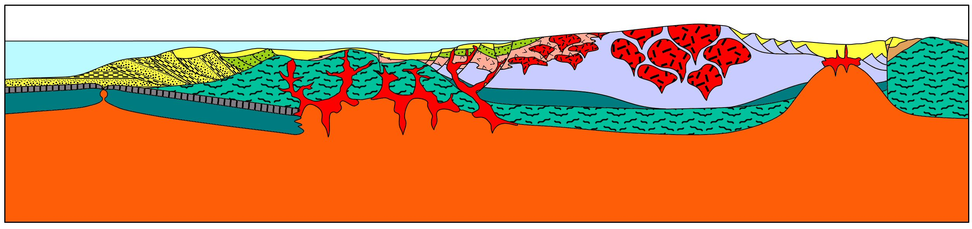
 | Termination of subduction, Thermal expansion, Tilting, Translation, Transtension, Transpression, Terracing | LATE CENOZOIC
T
Trench
East Pacific Rise
Pacific Plate
Farallon Plate remnant
Notes:
When the East Pacific Rise arrived at the trench …

Slide 11
 | Termination of subduction, Thermal expansion, Tilting, Translation, Transtension, Transpression, Terracing | LATE CENOZOIC
T
Formation of oceanic crust ends
Pacific Plate
Farallon Plate remnant
(Monterey Plate)
Path of Farallon Plate
Notes:
… production of oceanic crust ended as the accretionary wedge and forearc basin were thrust over the former spreading center. A portion of the Farallon Plate remains (now called the Monterey Plate), but the bulk of the Farallon plate continued to subduct and because no new oceanic crust replaced it…

Slide 12
 | Termination of subduction, Thermal expansion, Tilting, Translation, Transtension, Transpression, Terracing | LATE CENOZOIC
T
Uplift of PRB
Thermal expansion & plasticity
Greatest buoyancy
“anchor” removed
Tilted peneplain
Salton Trough
buoyant schist
Path of Farallon Plate
Mantle upwelling
Notes:
… mantle wells up to replace the area formerly occupied by the Farallon Plate. Upwelled mantle thermally expands the base of North American Plate making it both plastic and buoyant. Buoyancy also results from the relatively low density Catalina-Orocopia schists under-plated during the Early Cenozoic. Especially positive buoyancy occurs in the eastern Peninsular Ranges batholith where the dense anchor of lithospheric mantle was removed by subduction erosion and/or crust-mantle decoupling associated with the large amount of asthenosphere upwelled beneath the Salton Trough. Thermally-induced lower crust plasticity accommodated differential isostatic uplift which was much greater in the eastern Peninsular Ranges relative to adjacent areas such that the Early Cenozoic peneplain tilted west.

Slide 13
 | Termination of subduction, Thermal expansion, Tilting, Translation, Transtension, Transpression, Terracing | LATE CENOZOIC
T
N. Am. Plate
Spreading in the Gulf
Pacific Plate captures Monterrey and western N. American Plates
Salton Trough
San Andreas Fault
Pacific
Plate
Monterey
Plate
Path of Farallon Plate
Mantle upwelling
Notes:
The Salton Trough and Gulf of California (which are not underlain by a thick, buoyant batholith like the Peninsular Ranges) sank below sea level, because a great deal of spreading occurred there which thinned the crust so much that it could not float above sea level. Spreading in the Salton Trough is caused by several factors including mantle upwelling and a brief return of arc magmatism, but perhaps most important is that unlike the Farallon Plate, the Pacific Plate is not converging with the North American plate. The Pacific Plate is moving sideways and actually slightly away from the North American plate, which gives the formerly compressed continental edge room to spread out laterally and maintain contact with the otherwise slightly divergent Pacific Plate. The absolute motion of lithosphere west of the San Andreas Fault becomes similar to that of the Pacific Plate, and therefore effectively becomes a captured portion of the Pacific Plate.

Slide 14
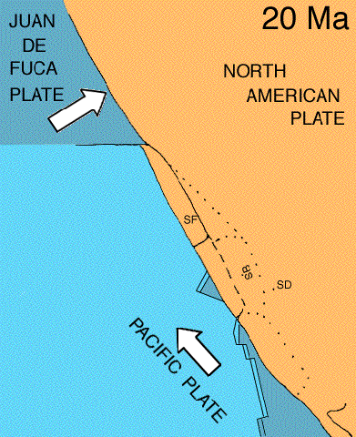
Translation
Notes:
In this animation we see how the largely sideways motion of the Pacific Plate ripped loose and captured great slabs of the western N. American Plate. Separation between these slabs, especially between San Diego (SD) and the much-rotated Santa Barbara (SB) slab, exposed the underlying Catalina-type schists which, because of their buoyancy and plasticity, flowed upwards as the confining weight of the upper crust was removed.

Slide 15
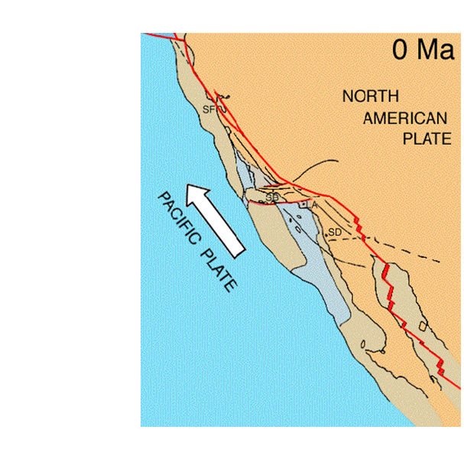
Core complex emplacement
Notes:
Such areas of exposed lower crust are known as core complexes.

Slide 16
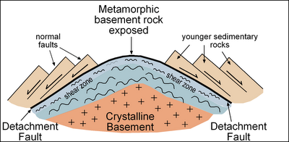
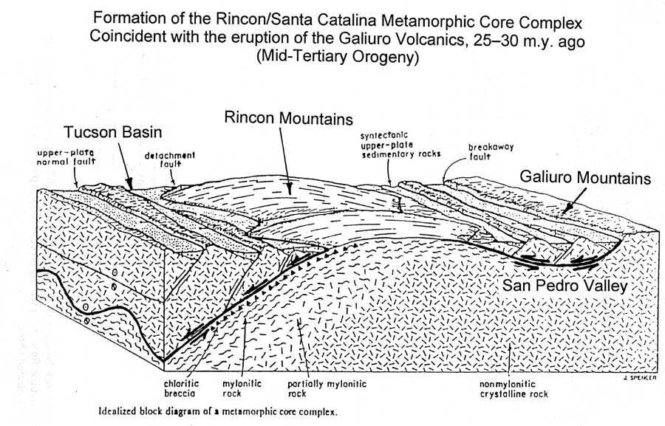
Core complex models
Notes:
There several core complex models, but all of them show the brittle upper crust rocks breaking into fault blocks which slide along a detachment fault between the brittle upper crust rocks and plastic lower plate rocks.

Slide 17
 | Termination of subduction, Thermal expansion, Tilting, Translation, Transtension, Transpression, Terracing | LATE CENOZOIC
T
Core complex (Orocopia schist)
Core complex (Catalina schist)
Salton Trough
San Andreas Fault
Path of Farallon Plate
Mantle upwelling
Notes:
Such is the case in the jumbled California continental borderland where the Catalina schist comprises the core complex. Tensional thinning of the upper crust near the Salton Trough releases a similar Orocopia schist-composed core complex in the Orocopia Mts. near the San Andreas Fault.

Slide 18
Decompression Melting and Basaltic Magmatism
Continental Borderland
Peninsular Ranges
Salton Trough
Decompression melting
Notes:
Compared to the Peninsular Ranges, the crust is much thinner in the Salton Trough and Southern California continental borderland so upwelled mantle can rise much closer to the surface in those areas. Thus decompression melting takes place in these areas, producing basaltic magma that works it’s way towards the surface. Some is emplaced as small, shallow plutons, but the thin crust allows much of the basaltic magma to reach the surface where most of it becomes buried beneath sediment which is especially thick in the Salton Trough.

Slide 19
 | Termination of subduction, Thermal expansion, Tilting, Translation, Transtension, Transpression, Terracing | LATE CENOZOIC
T
Faults
Pacific Plate
Farallon Plate remnant
Notes:
The core complex emplacement and the sideways motion of the Pacific Plate relative to North America severely faulted the continental borderland. Like the San Andreas, motion along most of these faults is primarily sideways, but vertical motion also happens where bends occur along the fault’s length.

Slide 20
Notes:
Looking down now on a bend along a right lateral strike slip fault, we can see that, depending on which direction the fault bends, localized areas of compression and extension will occur.

Slide 21
Transpression
Transtension
Notes:
Compression associated with lateral fault motion is known as transpression and the corresponding extension is called transtension.

Slide 22
Thicker crust
Thinner crust
Notes:
Crust tends to thicken in areas of transpression, while crustal thinning occurs where there is transtension.

Slide 23
Uplift
Subsidence
Notes:
Transpressional areas therefore tend to undergo uplift and ridge formation, while transtension causes subsidence and the formation of basins.

Slide 24
Ridge
Basins fill with volcanics and sediments
Notes:
Because crustal thinning contributes to the decompression of the underlying mantle, basaltic magma tends to form beneath the transtensional basins. Such magma reaches the surface as various volcanic rocks which fill the basin along with marine sediments.

Slide 25
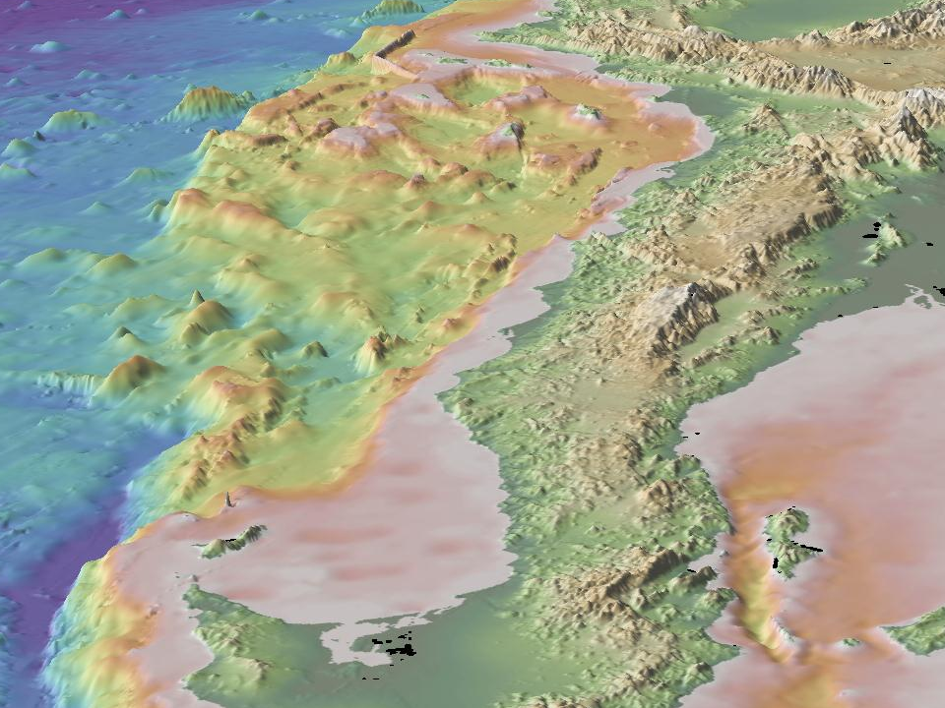
Continental Borderland
Notes:
So the continental borderland of southern California …

Slide 26
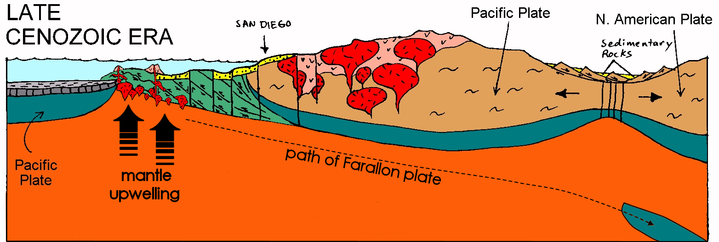
Transtensional Basin
Transpressional Ridge
Transtensional basins open in continental borderland
Notes:
… is comprised of transpressional ridges and transtensional basins filled with volcanic and sedimentary rocks. As lateral motion continues on these faults, ….

Slide 27
Transtensional Basin can become Transpressional Ridge
Stress patterns can change
Notes:
… stress patterns can reorient such that transpression may be applied to areas that formerly were subject to transtension. If that happens, the volcanic and sedimentary rocks that filled the transtensional basins can be uplifted and potentially exposed as islands. The volcanic rocks and most of the sedimentary rocks on Santa Catalina Island were exposed in this way, as is the case for uplift of most of the Channel Islands.

Slide 28
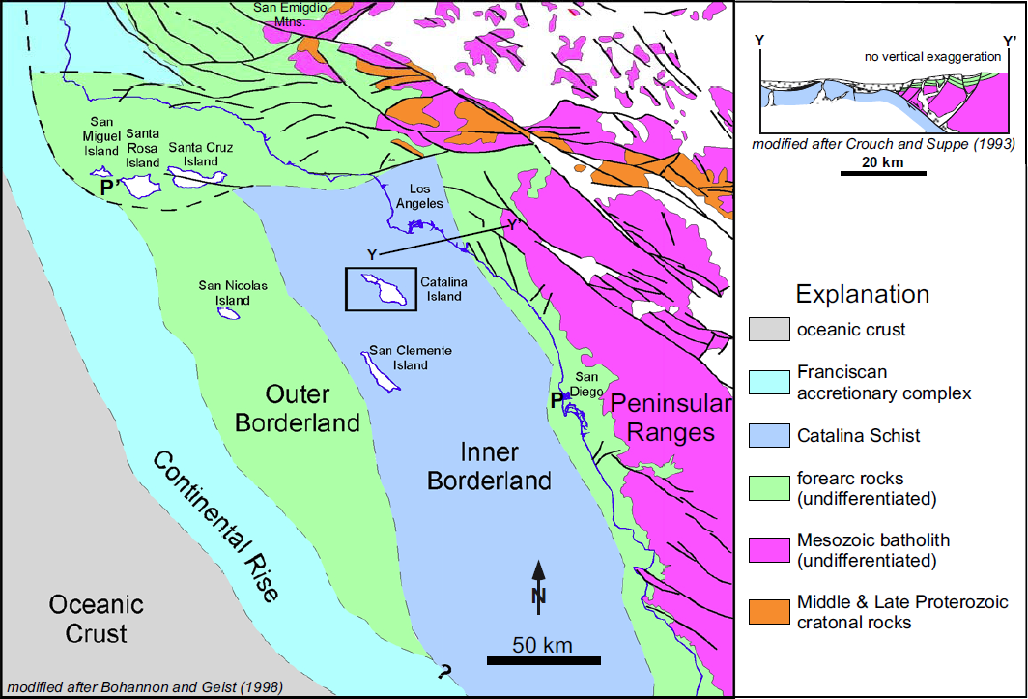
Notes:
In the inner Continental Borderland ….

Slide 29
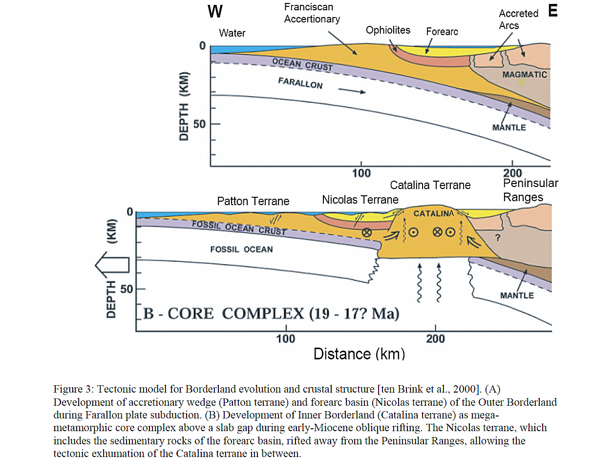
Notes:
… these structures are superimposed on the uplifted core composed largely of Catalina Schist.

Slide 30
Source for San Onofre Breccia
Transpression + Core Complex exposes wedge rocks
Notes:
In areas where local transpression was superimposed on the regional uplift of the core complex, the various metamorphic rocks of the old accretionary wedge could be exposed to erosion. The San Onofre Breccia represents that erosional debris.

Slide 31
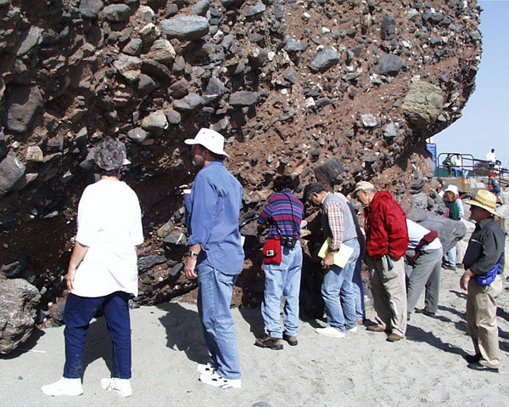
San Onofre Breccia
Notes:
This unusual and important unit contains large, angular rock fragments …

Slide 32
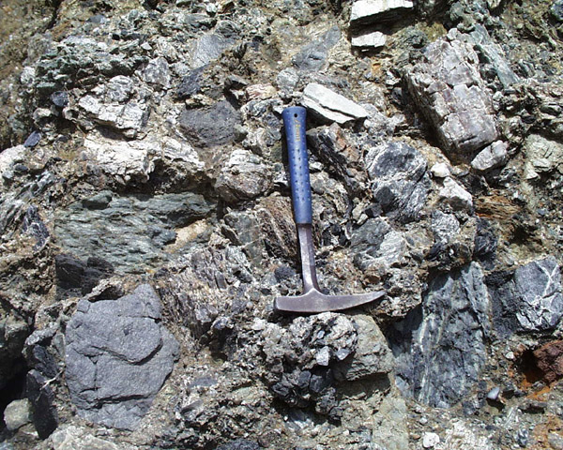
basalt
chert
greenstone
Quartz viens
blue schist
Notes:
… representative of the entire accretionary wedge.

Slide 33
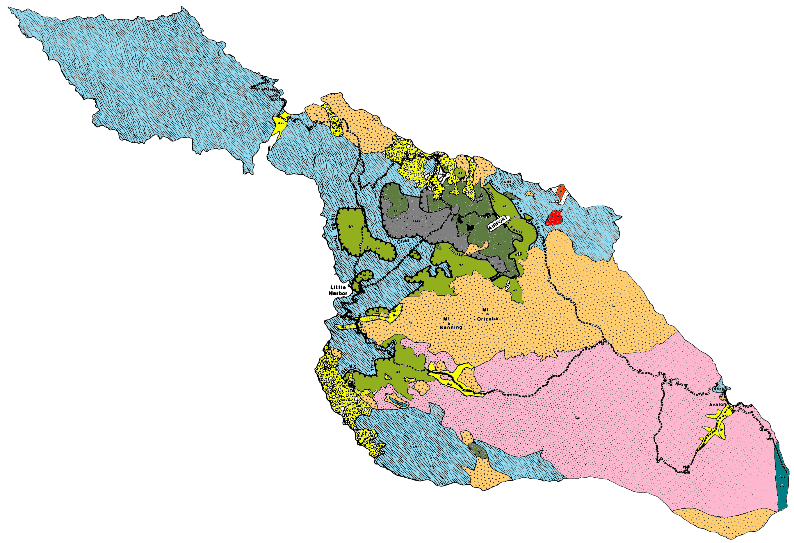
San Onofre Breccia
Notes:
Although we will not get to see this important unit, it does outcrop on the southeastern tip of the island where it represents the first sedimentary rocks to deposit on top of the volcanic rocks …

Slide 34
Mantle upwelling and decompression melting
Notes:
… produced by decompression melting. Note that some of the magma formed by decompression melting did not make it to the surface, but instead crystallized at shallow depths below the surface to form plutonic igneous rocks.

Slide 35
Plutonic igneous rock
Notes:
Such plutonic rocks (quartz diorite in this case) are represented by the large pink area at the south end of the island. This is the only granitic pluton known to intrude rocks of the California accretionary wedge.

Slide 36
Silver Canyon
Quartz diorite pluton showing sheeted structure
Notes:
The pluton has a pronounced sheeted structure because it was syntectonically emplaced along transtensional faults.

Slide 37
Volcanic igneous rock
Notes:
Associated volcanic rock is more variable and widely distributed on the island.

Slide 38
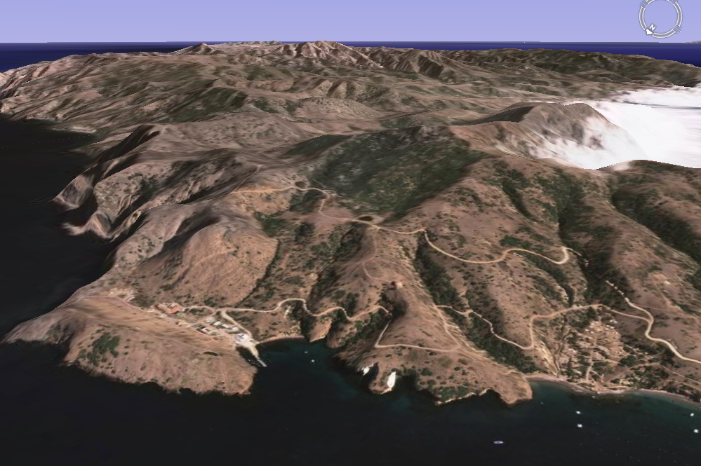
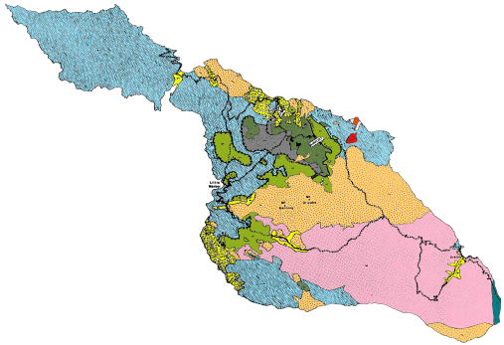
Campground
Notes:
Late Cenozoic volcanic rocks are particularly well exposed near the Two Harbors campground, …

Slide 39
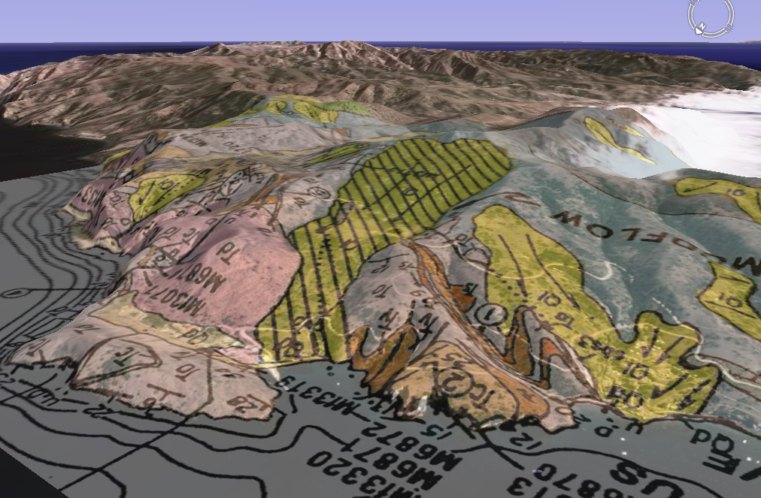
Volcanic igneous rock
Notes:
… as seen in this Google Earth overlay of the geologic map of the area.

Slide 40
Blueschist
Landslides
Notes:
Note also the numerous landslides (in yellow) – one of which lies directly beneath the campground! The sheared and foliated metamorphic rocks in the accretionary wedge basement are notoriously unstable.

Slide 41
Magma is heat source for hydrothermal circulation.
Notes:
Decompression-generated magma not only formed igneous rock, but it was the heat source driving the circulation of hot sea water through the continental borderland. Such hydrothermal circulation dissolved silica and other compounds from wedge rocks …

Slide 42
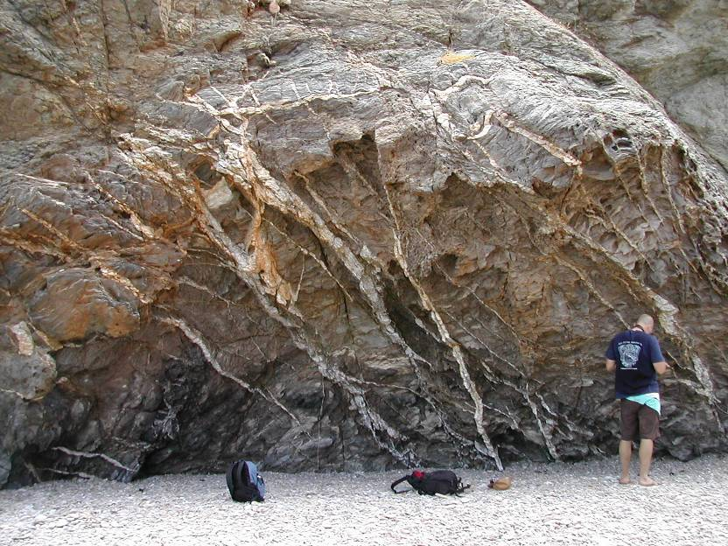
Quartz veining
Notes:
… and reprecipitated them as countless mineralized veins throughout the island.

Slide 43
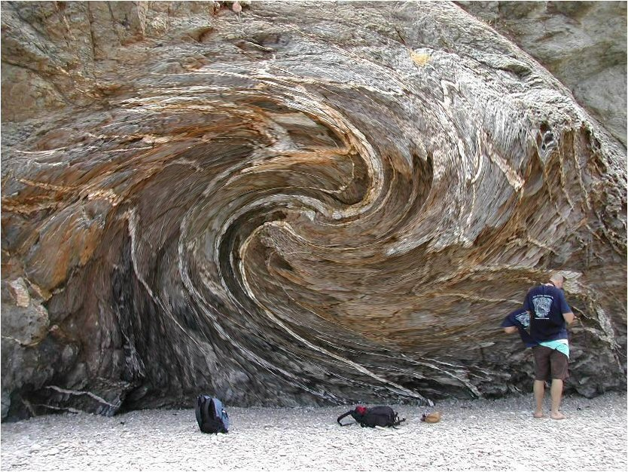
Notes:
Uh oh…

Slide 44
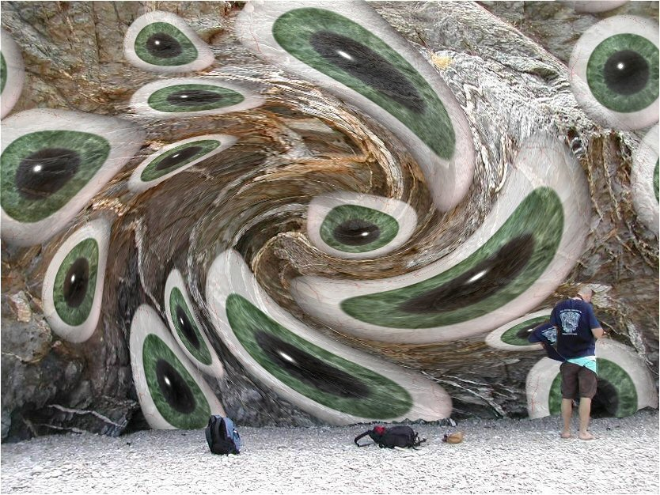
Notes:
… this rock must be …

Slide 45
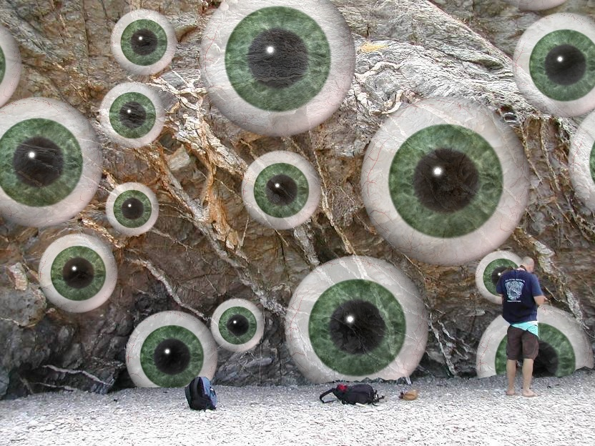
Quartz veining in greywacke
Notes:
… greywacke.

Slide 46
Diatomaceous shale deposits in transtensional basins
Notes:
Another consequence of Late Cenozoic magmatism in the continental borderland is the deposition of diatomaceous shale in the transtensional basins.

Slide 47
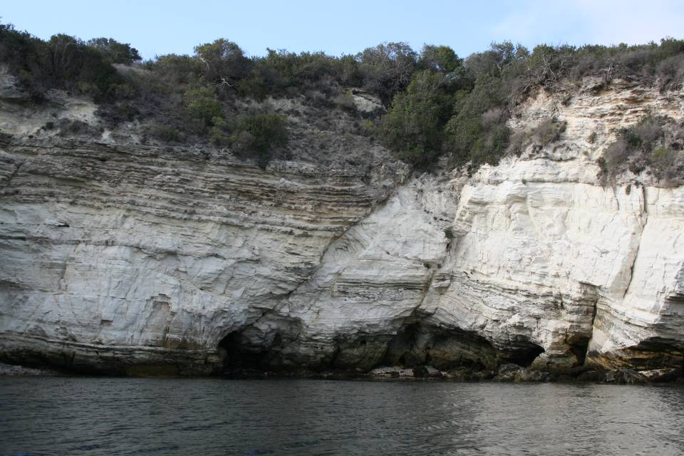
Notes:
The strikingly white cliffs of diatomaceous shale are probably the first rocks visitors notice upon arriving at Two Harbors by boat. The powdery rock is remarkably rich in diatoms – plant plankton that make their shells out of silica.

Slide 48
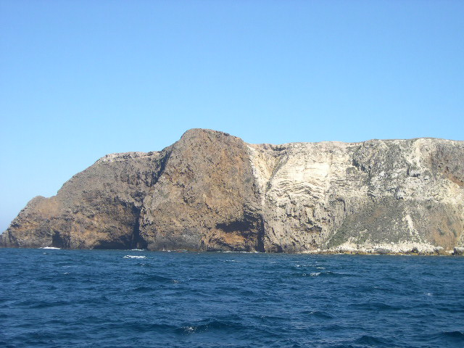
Transtensional basin
Volcanic rocks
Notes:
The purity of the diatomaceous shale is a function of how cut-off the transtensional basins where from the input of land-derived sediment, …

Slide 49
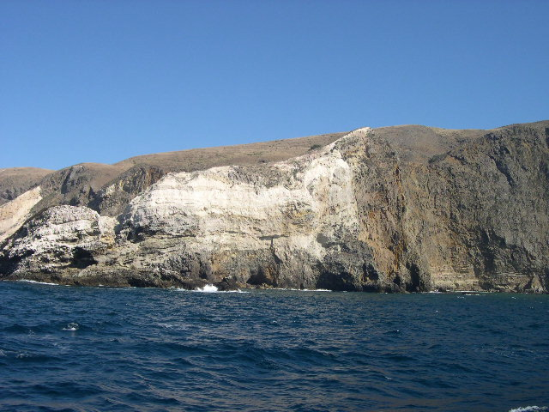
Notes:
… and how abundant diatoms where at the time, due to enhanced nutrient upwelling attributed to global cooling and currents flowing across the transpressional ridges.

Slide 50
 | EVENTS | ERA
 | Translation Transtension, Transpression Terracing | LATE CENOZOIC
 | Under-plating Uplift Un-roofing Undulating | EARLY CENOZOIC
 | Magmatic Madness Metamorphism | MESOZOIC
 | Stable Shelf Sedimentation | PALEOZOIC
T
U
M
S
Notes:
The final “T” word in our story - Terracing, …

Slide 51
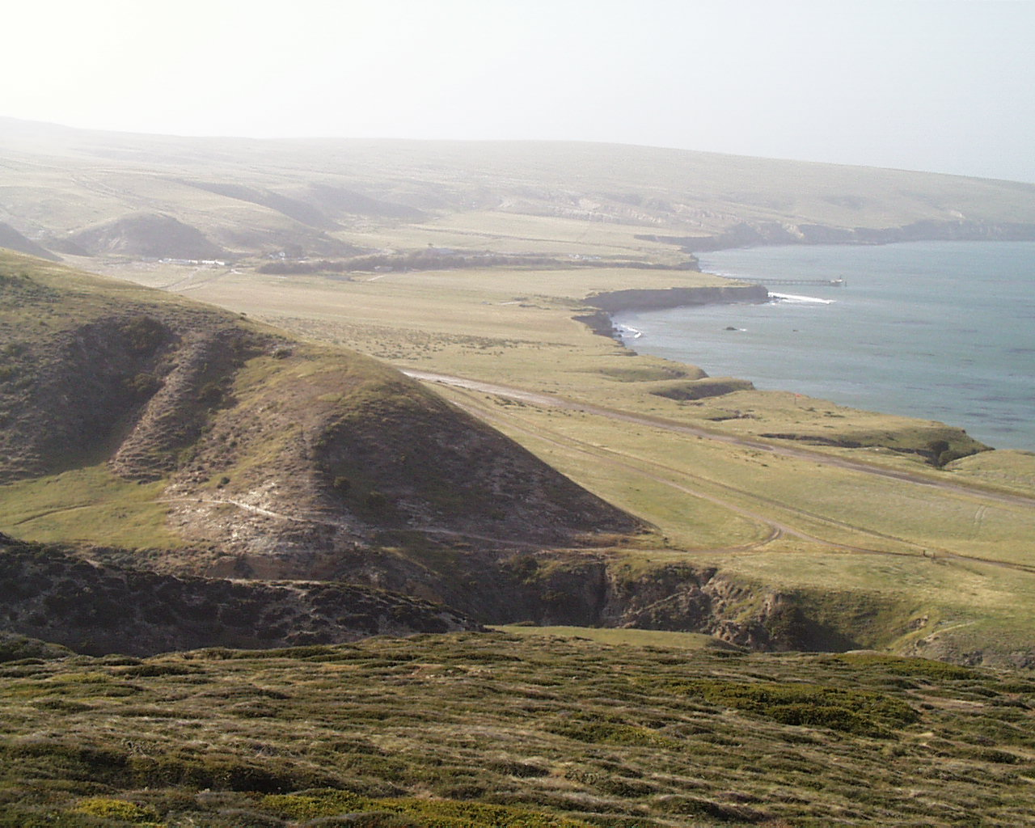
Marine Terrace
Santa Rosa Island
Notes:
… refers to the formation of marine terraces, which are uplifted wave-cut platforms.

Slide 52
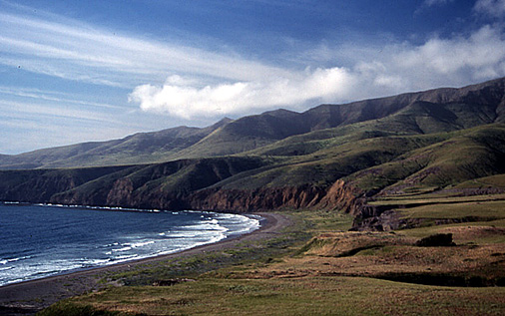
marine terrace
Santa Cruz Island
Notes:
They common throughout the continental borderland …

Slide 53
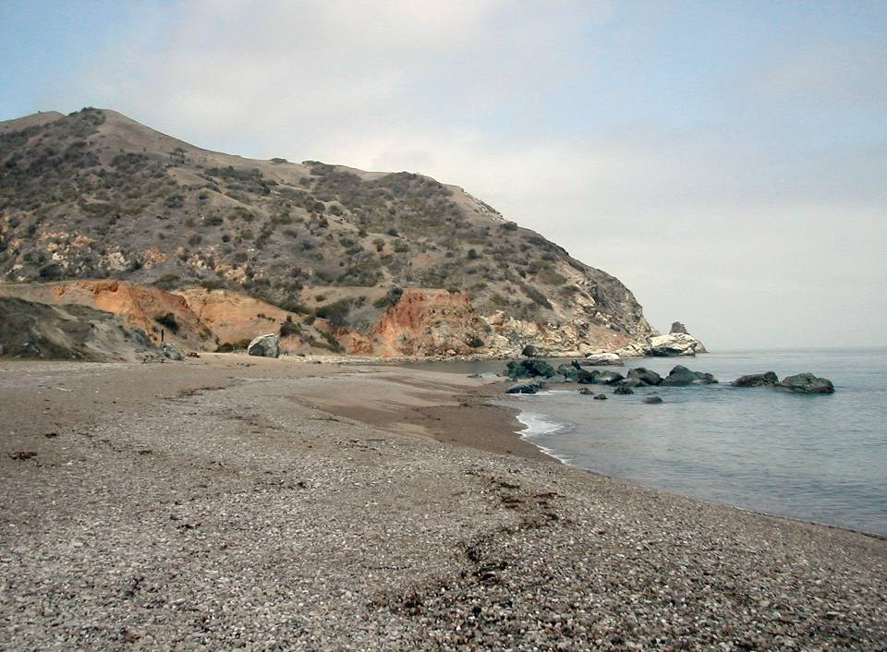
No marine terrace
Catalina Island
Notes:
… but generally absent on Catalina. Apparently this is due to the aforementioned instability of the fractured and foliated metamorphic rocks on Catalina. Marine terraces probably don’t last long before landslides and wave erosion destroy them. That wraps-up our introduction to the geology of Catalina Island.

Slide 54
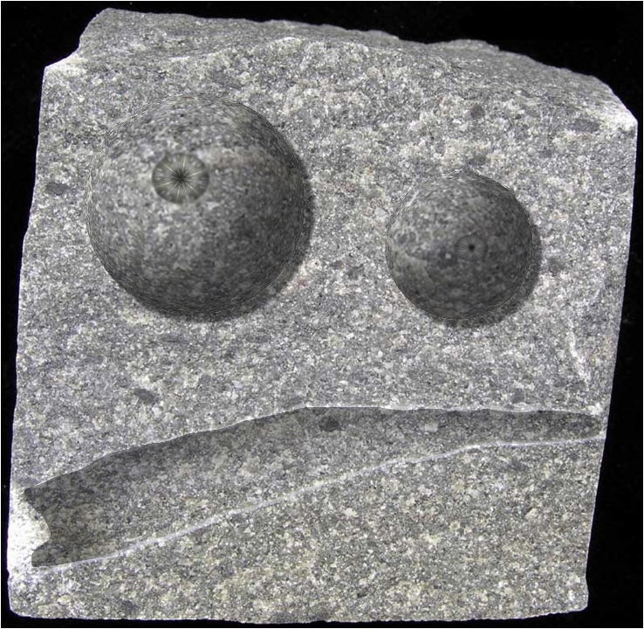
See you there!
Notes:
…

